Slide 1
CSI PACIFIC Return to Performance Program Proposal August 2025

Slide 2
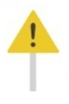
Multi Step Project “PITCH”
Step 1. The Problem
What problem (gap) are you actually trying to create a solution for?
Can you provide evidence that the problem exists?
Does the problem relate to the performance or health determinants of sport? Or could a solution to a problem result in positive impact for the institute, without negatively impacting our purpose? (if not, should we be trying to solve this problem?)
Try and distill the problem down to its simplest form. Ideally you should be able to describe the problem you are solving in one or two sentences or bullet points.

Slide 3
Step 1. The Problem
CSI Pacific does not have a RTP protocol
Every injury requires a massive time commitment for one of our practitioners
The problem is compounded by the fact that they must create the rehab program from scratch
As the practitioner is expected to provide a “state of the art” rehab, an immense amount of research is required
They must dive deeply into a plethora of nuanced topics.
Once they begin the rehab, they have no standardized way of keeping track of all the details
This makes it difficult to learn from each case, and to compound and share knowledge
Notes:
Summarize: This is a massive time commitment in the present, and we do not have the protocol set up to innovate or improve in the future.
CH:
-the purpose of this RTP program is to provide a world-class, evidence-based
pathway leveraging cutting-edge sport science and a multi-disciplinary team approach to
rehabilitate and reintegrate winter sport athletes back to an elite level of competition
-one-third of World Cup Freestyle Ski and Alpine Ski athletes sustain a time-loss injury each season (Florenes4
et al., 2012)

Slide 4
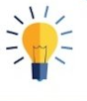
Multi Step Project “PITCH”
Step 2. Your Solution(s)
A clear problem statement will help you focus your solution on solving just one main focus problem.
Again you should be able to describe your solution(s) at a high level in just a few sentences or bullet points.

Slide 5
Step 2. Your Solution(s)
“Build something good with what we have now.”
An ACL Rehabilitation Protocol
Criteria Based Progression Injury -> RTP & Beyond
Training Program Templates
Neuromuscular Testing Protocol
Notes:
The Solution:
An ACL Rehabilitation Protocol
-Criteria Based Progression Injury -> RTP & Beyond
-Training Program Templates
-Neuromuscular Testing Protocol
A clear problem statement will help you focus your solution on solving just one main focus problem.
Again you should be able to describe your solution(s) at a high level in just a few sentences or bullet points.
What we have:
What we don’t have:
-money
-in house physiotherapy or other IST services
-isokinetic dynamometer
-underwater treadmill

Slide 6

Step 3. Target Market
NSO Partner Athletes
Next Gen
PSO
Performance Nation
Number of clients interested:
Notes:
Describe the market segments/type of client/customer you are targeting. Who does this problem focus on? What makes them unique? (e.g. is this just for elite athletes? Able or para or both? Next Gen? Community? Winter vs. Summer sports or both? NSO vs. PSO?)
Can you get any sense of projected number of client/customers that might be interested in this solution?
Are there any other aspects of the target market (or target customers/client) that are relevant to this problem and solution?

Slide 7
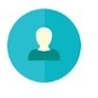
Step 4. Competition Benchmarking
-
Notes:
Who are your actual competitors? (name them, in some instances there might not be direct competition). Are they located locally, or within BC or within Canada or Internationally?
Describe your key differentiators that make your solution different than your competition.
[KPI: Is your solution unique enough that your target market (customers) will choose your solution over alternatives?]
Competition:
-CSI Calgary (collaborate)
-Private
-Fortius (n/a)
World Leading Examples:
(and one thing they do best that we can learn from)
-United States Ski and Snowboard
-SPARC Sports Physiotherapy & Athletic Rehabilitation Clinic – Ireland, Enda King
-OTP Return to Health and Performance ‘Think Tank’

Slide 8

Step 5. Highlight Your Team Advantage
Highlight how you and your time are the right team to execute on your vision!
Aspects of the CSI Pacific Institute Advantage should play front and center here. No matter how great or unique your solution is, if you don’t have the right people, places and programs, you won’t be able to see it to fruition.
Notes:
Highlight how you and your time are the right team to execute on your vision!
Aspects of the CSI Pacific Institute Advantage should play front and center here. No matter how great or unique your solution is, if you don’t have the right people, places and programs, you won’t be able to see it to fruition.
-My approach: Practical implementation > Science/Research/Innovation
-Experience leading successful ACL Rehabs
-Experience with successful and unsuccessful collaboration
-

Slide 9
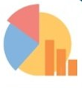
Multi Step Project “PITCH”
Step 6. Business Model
Ideally you can pull together a draft top-level forecast of potential revenues and expenses into a draft budget (a detailed forecast not needed now). What are the estimated projects costs to implement your solution? Is there enough revenues to cover costs in a sustainable manner?
The most important part is that you can show/articulate the business model, or within the context of sport, show that in a non-for profit model, there would be enough interest to support the solutions.
Notes:
CH:
-Increased and stable NSO and PSO investment in performance services

Slide 10

Multi Step Project “PITCH”
Step 7. Milestones
Highlight your upcoming goals and when you plan to achieve them. Consider developing a draft Gantt Chart for key milestones.

Slide 11
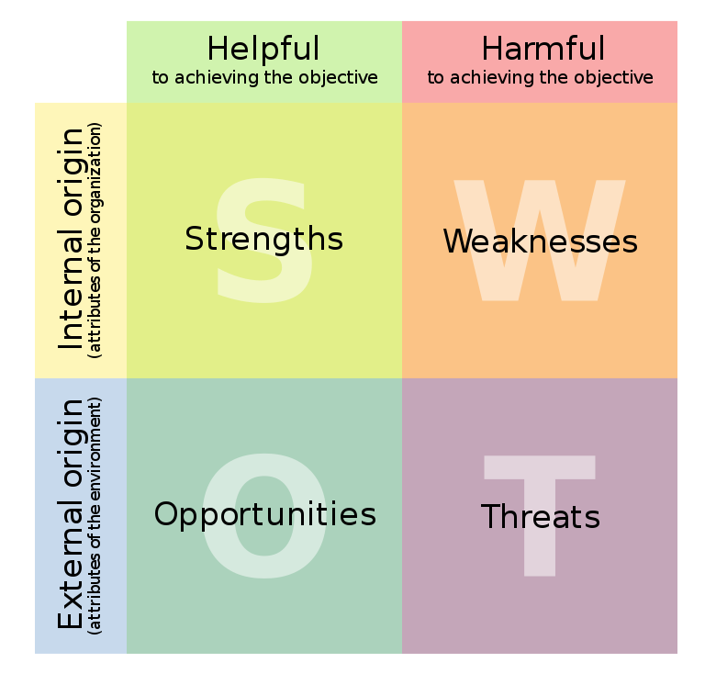
Multi Step Project “PITCH”
Step 8. SWOT (optional)
If you have been able to collect enough information in steps 1 through 7, consider developing a single slide SWOT analysis.

